Slide 1

What will your kids know about sex and who will tell them?

Slide 2

How and When To Tell Your Kids About Sex
A Lifelong Approach To Shaping Your Child’s Sexual Character

Slide 3

Getting the Big Picture
Primary Goal of Christian Parenting
  to equip and empower our children to enter adulthood capable of living godly, wholesome, and fulfilled lives as Christian men and women, Christian wives and husbands.
Notes:
Many parents focus too narrowly and negatively when they think about goals for sex education. Worried by what they hear about sexual promiscuity, sexually transmitted diseases and the like among young people, parents seek to protect their children from the ravages that illicit and irresponsible sex can cause by convincing their kids not to have sex. Rightly so. But this goal is too small, too limited, too narrow. If we stop there, we only seek to protect them by stopping them from doing anything negative.
Don’t we want to give them something profoundly positive? Protecting our children from the physical, emotional, and spiritual damage that can result from irresponsible and inappropriate sexual choices is important. But our most important goal is to equip and empower our children to enter adulthood capable of living godly, wholesome, and fulfilled lives as Christian men and women, Christian wives and husbands.

Slide 4
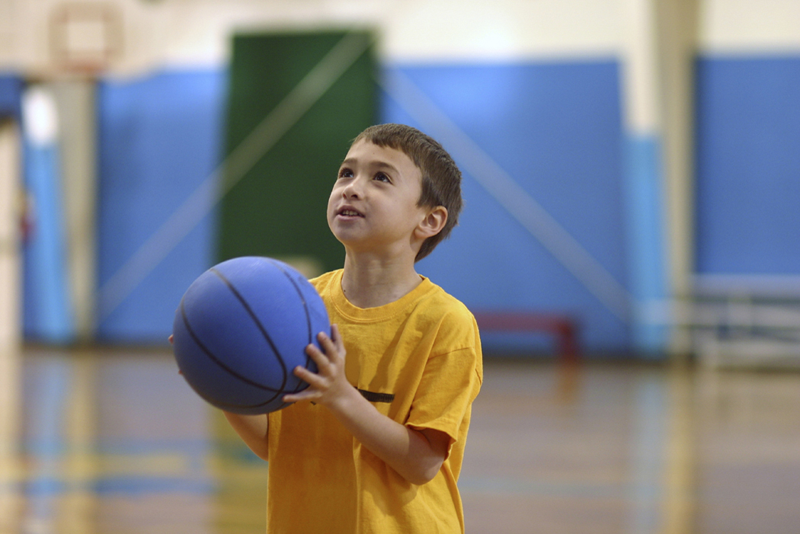
Sex Education Goal for
Christian Parents
to prepare them to become the kinds of adults who can have deep and meaningful marriages filled with spiritual, sexual, and emotional intimacy, and who can have loving and deep family relationships and friendships.
Notes:
Our goal is to prepare them to become the kinds of adults who can have deep and meaningful marriages filled with spiritual, sexual, and emotional intimacy, and who can have loving and deep family relationships and friendships. Sex as God intended it is the giving over of the astonishing gift of our very selves to another in marital union. Sex education is about preparing our children for giving this gift rightly; preparing them to be able to love and trust and believe enough to commit their whole selves and their whole futures to another. When we do this, we also protect them.

Slide 5

Session four:
The Transitional Years – Through Puberty

Slide 6
Preparing for Puberty and Adolescence

Slide 7
Explaining Puberty to Your Child
Be Positive and Affirming
Present Puberty as a Gift, not a Curse
Start the Discussions Early (Late Elementary)
Notes:
The age of onset of puberty has been steadily decreasing. The average age for onset of menstruation for girls is now under age twelve. Some girls, in fact, are beginning their menstrual periods as early as age nine, though others can begin their periods as late as age sixteen or seventeen. Boys are beginning to go through puberty between the ages of thirteen and fourteen. It is not at all uncommon for persons to be sexually mature for just as long in their life before they marry as they were sexually immature. The average boy spends thirteen years before puberty and then fourteen years after puberty before he marries, and the average young woman today spends twelve years before puberty, and then thirteen more years as a sexually mature woman before she marries.
We summarize here some of the things you need to tell your children in the kind of language you might use with your child during the late elementary school years. As you discuss these changes with your sons and daughters, work hard to be positive and affirming. Tell kids they will be receiving a gift in installments over the next few years, the gift of an adult body. God is the gift-giver, and God means them well with His gift. Explain that you as a parent are excited about that gift, and you want to help them know as much as possible about the gift and how to use it wisely and well. Start these discussions early, before the actual onset of puberty. With the acute self-consciousness kids feel going through puberty, discussions about their bodies and their experiences can be more difficult during puberty itself.
We have written two books for kids in the pre-puberty period. What’s The Big Deal? Why God Cares About Sex (Book 3 in the God’s Design For Sex series) is written for kids eight to eleven and is designed for a parent and child to read together. Facing the Facts: The Truth About Sex And You (Book 4) is written for kids eleven to fourteen. Facing the Facts is designed for your child to read alone, though we urge you think about reading it alongside your child and talking about the issues it raises. Ideally, we think each of these books is designed to be read early in its designated age ranges, particularly Facing the Facts in preparation for puberty around age eleven or twelve. These books contain thorough examples of how to talk to your child about the changes of puberty, and so we will be brief here.

Slide 8
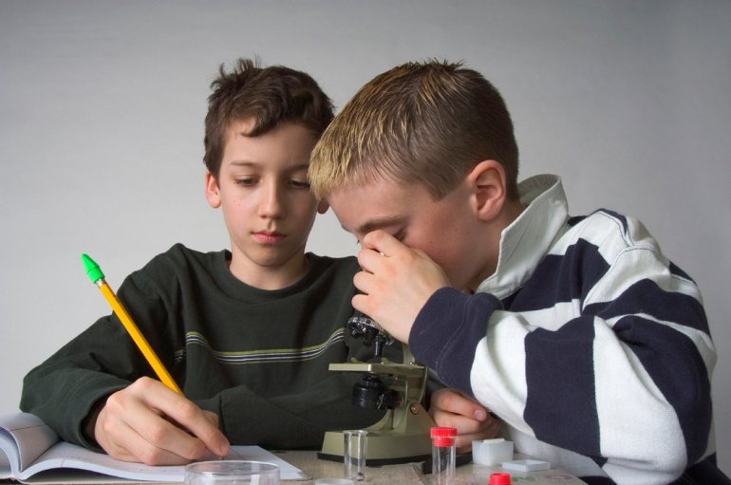
What to Say about Same Sex Attractions
Pre-adolescent and Adolescent Sexuality Is Unfocused
Promote an Open Conversation about Urges
Don’t Label Behavior as “Gay” or “Homosexual”
Discipline for Violating Privacy and Sanctity Issues
Be Compassionate
Notes:
What to Say About Uncomfortable Urges
You can tell both boys and girls that the sexual feelings and yearnings they will feel during and after the puberty period can be powerful, mysterious, and at times very uncomfortable. One of the most troubling but common experiences of many teens is to feel sexual arousal in unexpected ways. Boys especially can find themselves sexually aroused by girls they don’t like or find to be unattractive. They may feel sexual attraction to a cousin, sister, or friend of the family. They may get “turned on” to lewd jokes describing deviant sexual acts, or to TV commercials or magazine ads. The same thing can happen to girls—they can feel aroused by someone they dislike or by thinking about rape.
Because teenage sexual arousal can be unfocused, many normal heterosexual teens find themselves on occasion feeling a sexual response to hearing about homosexual acts or to thinking about another girl or boy’s body. Help teenagers to take this in stride by recognizing it for what it is. They are going through a period where identity as a sexually mature adult is being shaped. Remember the study we mentioned in Chapter 8 showing that only 11 percent of teens who initially reported they had some same-sex attraction still reported those feelings one year later. Early on in this process, they do not have as definite a “form” to their sexuality as they will later. Warn them about these experiences, and tell them not to worry about them. Such occasional feelings are to be expected, and will eventually resolve. Their job during this period is to be thankful for their awakening sexual feelings, make the right decisions that God wishes of them, enjoy their relationships, and be patient with themselves as they grow up. They do not have to act on any of the sexual feelings they experience.
Some children and teenagers engage in sexual experimentation, including same-sex behavior, and this needs to be discussed as well; we discussed these statistics in Chapter 2. Same-sex experimentation can take the forms of guys wrestling and grabbing each others genitals, girls practicing kissing or petting as they talk about dating, two boys watching each other masturbating, and so forth. It is vital not to label such behavior as homosexual; to do so is to brand the person on the basis of an action. If you discover your child engaging in any of these activities, never say, “Stop that homosexual play!” or “Are you trying to become gay?” Children can be branded with doubt by such statements. Instead discipline them for their failure to protect the privacy and sanctity of their own body, but always in the context of affirming their basic “normalcy.”
At the same time, we should talk with them compassionately about the feelings that might have been associated with their actions: curiosity, fear of not fitting in, loneliness. We might say something like (for ten-year-olds), “Bill, because you were engaging in sexual play with Jeremy, showing each other your penises, you are restricted from playing with him for one week. Acting like that is inappropriate. It is very normal to be curious about another boy’s body. But you are meant to keep your body private, so that you will be able to make it a special gift to your future wife. Your body and its sexual feelings are a special gift from God to you. I’m punishing you now because you did not make a good choice of how to use that gift.” If children confess such actions to us, we should again talk with them with compassion, and also help them to structure their lives to try to make sure it doesn’t happen again.

Slide 9

Four Predictors of Teen Sexual Experimentation
Closeness of Parental Relationships
Amount of Sexual Experimentation among Peer Group
Teens Religious Beliefs and Practices
How Intent on and Confident the Child is of Success and Achievement in School
Notes:
Scientific research shows four factors to be significant predictors of teenage sexual experimentation (and each of these is rooted in one of the five aspects of sexual character that we have been discussing):
<Note: Insert mini weight-lifter character diagram/graphic here>
the closeness of the relationship of the child with his or her parent (character factor: needs)
the amount of sexual experimentation that goes on in the peer group (character factor: needs, supports)
the teen’s religious beliefs and practice (character factors: needs, values, beliefs, supports)
how intent on and confident the child is of success and achievement in school (character factors: needs, values, beliefs)
We discuss each of these and their implications for parenting below. Each of these factors exerts its powerful influence on sexual behavior in adolescence, but parents will be too late if they wait for adolescence to begin working on these factors.
We survey this research in S. Jones & J. Laskowski, ibid.

Slide 10
Preparing for Romance, Sexual Attraction, and Dating
Notes:
What do you plan to do about your child and dating? In this chapter we will outline the kinds of issues parents should think through and talk about with kids during their transition through puberty, in preparing for dating. We should gently but firmly surround our teenagers with a supportive framework of rules about romantic relationships that will allow them time to mature and grow in strength before they face the challenges that adulthood will offer them. Hopefully, as they move into readiness to form and experience such relationships, the following are increasingly true:
You have built a history of helping them meet their needs for relatedness and significance in healthy and godly ways. Teenagers who enter romantic relationships feeling a deep sense of love and acceptance from parents and from God, and with a sense of confidence in the meaning of their own lives and ability to serve God well with their gifts and abilities, are strong young people. These teens also understand their deepest needs, and can make mature decisions about how to get those needs met.
You have supplied them with the most important core beliefs about sexual morality, with accurate information about sexuality, and with growing understanding of what love between a man and woman is like.
They have come to value the right things. Adolescence is when we begin truly to discover whether we have taught them by example and word to value conformity, approval of others, and self-gratification, or rather chastity, strength, independence, purity, and obedience.
They have the skills to handle themselves well. They can resist peer pressure, say No!, defend themselves, think through situations and risks, and articulate their beliefs.
They have a supportive relationship with you, the parent. Your support, provided in the forms of affection and encouragement but also rules and limits, can give strength at a time when others are weakening them. They also have positive and supportive peer relationships.

Slide 11
The Realities of Romance and Dating
Dating or Courtship?
Changing Realities
Notes:
Research shows clearly that over 90 percent of adults will marry during their lifetime. The average age at which they marry for the first time is now above 25 and 27 for women and men, respectively. Thus, teenagers experiencing the first blush of romantic attraction are typically facing many years before they will commit themselves in marriage to another. You can help your children think in godly, positive, and long-term ways about how they will handle their romantic feelings and relationships in order to honor God and experience His best for them for the rest of their lifetimes. Speak candidly with them about how their actions in their teen and young adult years will set the stage, for better or worse, for what they will experience for the rest of their adult lives.
Dating or Courtship?
Perhaps the first thing you’ll have to settle in your mind is what you believe about dating. In the first edition of this book, we took a positive, up-beat stance toward dating, trying to provide suggestions for how a teen could honor God in dating relationships. What we said generated some strong negative reaction. We discovered what we had previously been unaware of: that some fellow Christians believe that dating itself is a corrupt social practice that fosters immorality and relational confusion, a practice that should be replaced in Christian families by what they argue to be a biblical pattern of “courtship.”
Courtship relationships are modeled after what is understood to be a biblically-mandated approach to establishing marital relationships. There are no examples in the Bible, they argue, of emotionally intimate male-female relationships outside of marriage. Advocates of courtship tend to argue two points based on Numbers 30 and those biblical passages that describe how biblical figures married. First, we should reject the invalid, failed, and fictionalized notion of the lightening-bolt of “true love” telling you that you have found “the ONE.” Instead, we should embrace a biblical understanding of marital love that grows in the context of mutual submission to Christ and of utter and complete devotion to your spouse based on obedience to Christ. Second, romantic relationships between and man and woman should only happen when the man and woman are actually considering marriage, and should be under the spiritual authority and practical oversight of the woman’s parents (i.e., her father).
We resonate with some of the deepest concerns of courtship advocates. First, many young people do have an unrealistic view of romantic love. They think that we are passive as loves strikes us, and then perhaps later dries up leaving us free to fall in love with another. Hence, we must wander from relationship to relationship seeking the desired bolt-from-above. Christian marriage is undergirded with something much stronger and enduring. Perhaps no one has said it better than C. S. Lewis:
<inset quote>
Love as distinct from “being in love” is not merely a feeling. It is a deep unity, maintained by the will and deliberately strengthened by habit; reinforced by (in Christian marriages) the grace which both partners ask, and receive, from God. … “Being in love” first moved them to promise fidelity; this quieter love enables them to keep the promise. It is on this love that the engine of marriage is run; being in love was the explosion that started it.
<end>
We also agree that dating is unhealthy if understood as a revolving door of emotionally (and sexually) intimate couplings. Further, dating should not be utterly isolated from one’s family, especially in the teen years. Finally, we agree that one does not best prepare for marriage by forming and breaking a long series of romantically-intense and exclusive relationships.
But these agreements do not take us to the place of rejecting dating in favor of courtship. The core reason is that we do not see the pattern described in the Bible for establishing marriage as necessarily mandated by God as the only way to establish marriages. Just because the Bible never describes democracy as a form of governmental rule in the Old Testament does not mean that it is an invalid form of government today, and similarly we do not believe that relationships between single young people today need to follow Old Testament courtship patterns precisely. What we must preserve are the biblical moral absolutes for relationships that have been the focus of this entire book.
Some of the more popular books promoting this view are Joshua Harris’s Boy Meets Girl and I Kissed Dating Goodbye (both published by Multnomah), and Sex and the Supremacy of Christ, John Piper and Justin Taylor, editors (2005, Crossway Books).
C. S. Lewis, Mere Christianity (New York: Macmillan, 1943), page 99.

Slide 12
Dating or Courtship?

Slide 13

Changing Realities
Three Cautions
  Discourage Early Romance
  Beware of Dishonesty
  Education about Date Rape
Notes:
Changing Realities
It is very hard today to speak with any confidence about any “general” picture of the romance scene for young people. “Dating,” as it was practiced in the 1970s and 1980s has become much less common. Young people today are much more likely to do things in groups, and less likely to have formal “dates.” One study on college campuses found that two-thirds of women had five or fewer dates in their entire four-year college experience. Dating has been replaced by informal “hanging out,” but also increasingly by “hooking up.”
Hooking up today means casual, relationship-less sex where the two individuals involved gratify each other’s sexual appetites, but without commitment and without any perception that their sexual interchange means they have a stable relationship. Parents need to encourage and challenge their pre-teens and teens to conduct their relationships in a way that runs counter to the culture and honors God.
We’d like to sound specific cautions.
Discourage early romance. Given the realities today of when marriage tends to occur, parents should discourage early involvement in romance. There is strong evidence that adolescents who start dating early are more likely to begin having sexual intercourse early. Those who mature early are more likely to get into trouble with premarital sex than are “late bloomers.” Because of the influence of peers, kids who are in groups that start dating early are at greater risk. Early dating is not harmless.
Beware of dishonesty. There is a high level of dishonesty in many adolescent dating relationships. Studies continue to show that teenage boys, in particular, feel it is okay to exaggerate or even lie about their feelings for the girl, especially to get sex. Lying about one’s sexual history (previous partners, STDs—even HIV) is also rampant. We need to give a clear sense to our kids of the extent of trust that is reasonable, and that when it comes to sex both men and women have many incentives to be dishonest.
Warn of date rape. We must warn our girls in particular about the growing prevalence of date rape and forced sex; we discuss this at the end of this chapter.
C. Hayes, ed., “Determinants of Adolescent Sexual Behavior and Decision Making,” in Risking the Future: Adolescent Sexuality, Pregnancy, and Childbearing (Washington: National Academy Press, 1987), page 103.

Slide 14

Expectations of Teen Relationships
Teen Relationships Are Valuable
Sex Is Not Everything
Tell Your Stories
Notes:
Begin your discussions with teenagers by talking about the purposes their teen relationships should serve.
Teen Relationships Are Valuable
Teenagers need positive expectations for teen relationships. We must try to strike a balance between giving them positive expectations that will serve them well later on the one hand, and on the other hand encouraging caution and restraint in building romantic relationships while they give themselves time to mature.
Teen relationships present the opportunity to have fun and to enjoy different activities, and to get to know a wide variety of people and for teens to learn better what they really like and respect in people. They are a great place to enjoy friendships with and learn more about the other sex. Good marriages are built, in part, on friendship with your spouse and on an understanding of the other person. Our kids can begin the process of becoming good spouses by learning to be friends with the people of the other sex.
Teen relationships are also an opportunity to grow in confidence and skill at handling yourself in challenging situations. When friendships and dating relationships are handled rightly, teenagers will be able to gain self-assurance as they slowly move out from the family and successfully handle the challenges they will face—peer pressure; confusion; how to stop, slow down, or deepen intimacy; and how to put a stop to a relationship that is no longer healthy or helpful.
Sex Is Not Everything
Parents often do their kids a disservice by focusing so much on the sexual dimension of romantic relationships that they ignore the greater significance of the emotional dynamics. We feel strongly enough about this to offer it as our next principle:
<treatment> Principle 11: Sexuality is not the most important thing in life.
What do people ultimately want from their human relationships? Sexual thrills only satisfy the most superficial levels of our yearnings as persons. We must keep our sexuality in proper perspective. Sexuality is a vital and beautiful gift, but it is itself a signpost pointing us to a deeper reality—our capacity to love God and to love and become one with a special person. All of the smoke about sexual feelings can hide the real fire creating the smoke. The adolescent finds out in his or her heart what each of us must ultimately discover: That we are made to be incomplete by ourselves, and that we long for union with God and another special person to be made complete. In their awakening to a desire for a romantic relationship, our kids will experience the powerful emotional awakenings of their true self, the self that is restless until it rests in a relationship of union with God and spouse.
These relationships are thus an opportunity to feel strong feelings of interest, infatuation, or even to fall in and out of love, and thus over time to learn what true love really is. Teenagers must understand that they will experience such ups and downs many times before they learn what real love is—though no one really understands this until they go through it. These relationships are a great place to learn that “love at first sight” is mostly an illusion; teens learn this reality as feelings come and go. They can learn that it is not really easy at all to distinguish infatuation from real love, but that the best test is simply to be patient and see if the feelings endure. Another of the differences between infatuation and true love is that true love can see flaws in the other and still love. Any real relationship can stand the test of time, and if it can stand the test of time it can also stand the test of sexual restraint. We should never interpret for our kids that what they are feeling at age sixteen is not true love. Rather, we should rejoice with them that they feel love, and encourage them that if what they are experiencing is true love, it will be deepened and made yet more beautiful by sexual purity and exercising the patient discipline of allowing the relationship to develop slowly. James Dobson has a helpful discussion of many other myths of “love” in his helpful book Preparing for Adolescence.
Tell Your Stories
Remember the power of stories. One of the most helpful things you can do as a parent is to tell your stories to your kids. Tell them of the ups and downs we experienced. Tell them what the power of infatuation felt like when you were sure it was lifelong love. Tell them about the obsessive way you wrote your flame’s name over and over, the way your whole day revolved around when he would call you, or the way you got an electric thrill to see her smile at you. Tell them about your confusion and pain as a relationship died a lingering death. Tell them about the agony of betrayal. Tell them about the fear of asking out the one you thought you adored. Tell them of the boredom and frustration of discovering that you were not enjoying the one you were with. Tell them how your powerful feelings blinded you to his flaws and led you to exaggerate his perfections. Do all this to give your children a wider range of experiences, namely your experiences, to serve as a vantage point from which they can see their own experiences more clearly.
In their relationships with the other sex, teens will experience feelings of sexual attraction and have the opportunity to learn how to handle those feelings rightly and glorify God in the process. It’s a normal and good thing for them to feel sexual excitement for someone they care for, to want to kiss, to touch and be touched, and even to want to be united with someone sexually. But we must also tell them, again, that they do not have to act on those feelings, that it will not hurt them not to act on those feelings, that if it is a godly relationship then it will not hurt the relationship either, and that God wants them to follow His rules. They also have the opportunity to learn that sexual attractions to other people do not disappear when we feel infatuation and love, and that sexual purity requires discipline. A dating relationship is a wonderful place to follow God’s commands and see how He will bless obedience and purity.
Dating is an opportunity to grow to love your future spouse. We probably should not utterly separate teen dating from its connection to marriage; after all, some people do begin dating their spouse-to-be in the teen years. But we should balance this possibility by gently letting teens know that many long dating relationships do not make it to the altar.
James Dobson, Preparing for Adolescence (Ventura, CA: Regal, 1999), pages 87ff.

Slide 15
Guidelines for Romance and Dating
Notes:
Parents should not think of romantic relationships and dating in an “all or nothing” way. Kids’ romantic relationships take many different forms today, and you need to have rough ideas of what you judge to be healthy at different ages, and hence of what you will allow and approve of. Some patterns of dating have more potential than others to move adolescents toward more sexual experimentation—the more individual and private the pattern, the more likely it is to cause trouble.

Slide 16

Set Wise Limits
How Old Is Old Enough?
How Much Time Together?
Is There a Plan?
Monitoring Private Time

Slide 17
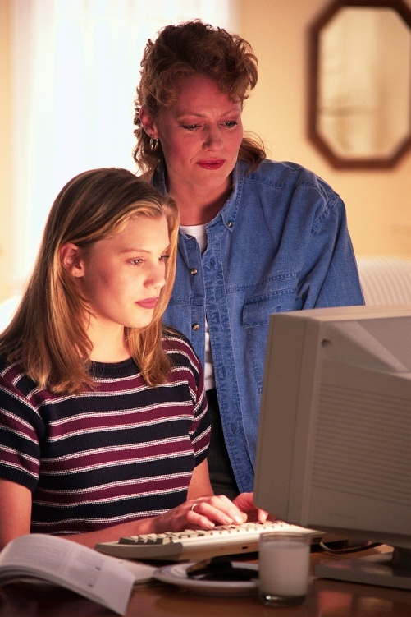
Makes Teens Accountable
Notes:
Makes Teens Accountable
Teens should be accountable to definite plans and guidelines. “Hanging out” is not a good plan, especially in early dating. Specific activities at specific locations should be the rule. Having the couple engage in deliberate forethought about what they will be doing can help prevent disastrous, spontaneous “doing what comes naturally”! Parents today should beware the illusion that cell phones establish accountability; just because you can reach your child does not mean you know where he or she is.
Couples should avoid sexually explicit media as part of their activities. Urge teenagers to choose activities wisely, and set limits to the kinds of activities they can pursue.
The following mostly based on J. McDowell and D. Day, Why Wait? (San Bernardino, CA: Here’s Life, 1987).

Slide 18

Urge Teens to Dress Modestly
Notes:
Urge Teens to Dress Modestly
Teens, especially young women, should dress modestly rather than provocatively. Everything a young woman does in a relationship, from mode of dress on, communicates some message about her moral standards. Young women from Christian families should not send out mixed signals.

Slide 19

Remind Teens to Choose Companions Carefully
Notes:
Remind Teens to Choose Companions Carefully
Teens should choose all of their companions, especially those they date, very carefully. Our companions will shape who we are (Proverbs 13:20, 28:7, 29:3).

Slide 20

Clarify Moral Standards
Notes:
Clarify Moral Standards
Teens should be prepared to state their moral standards with someone they are dating. Teens should set their physical limits and standards early and firmly. No infringements of their standards should be accepted. Many Christian boys today are having problems with sexually aggressive girls who push the young man to experiment sexually; teenage boys need to be prepared with their limits every bit as much as girls. We will discuss “where” to set these limits in the next chapter.

Slide 21

Be aware of spiritually charged settings

Slide 22

Blast the Obligation System
Notes:
Blast the Obligation System
If boys pay for the activities of a date, girls often feeling obligated to the boy, that they somehow “owe” him. Many boys subtly encourage this feeling of obligation and have a specific repayment plan in mind for their monetary investment in the date! The place to start in dealing with this problem is awareness—we should warn our daughters (and sons) about this occurring, and make it very clear that they never owe part of their body to anyone. If the date seems to want something back, have the teen tell the date that her parents will be more than happy to refund half of the cost of the date with interest!

Slide 23

Steer Kids Away From High-Risk Situations
Notes:
Steer Kids Away From High-Risk Situations
Teens should be urged to avoid high-risk situations. “Parking” alone in a car miles from anywhere is very risky, as is being alone in a house or apartment with no responsible adults around. Situations where men outnumber women drastically should be avoided or a hasty departure made. Perhaps the most risky situations are those where alcohol and drugs are involved.

Slide 24

Take an Absolute Stand on Alcohol and Drugs
Notes:
Take an Absolute Stand on Alcohol and Drugs
Parents should take an absolute stand that their children not be allowed to consume alcohol or drugs or be around others who are consuming them. Not only are alcohol and drugs problems in themselves, but numerous studies have found that kids who take risks with alcohol and drugs are also very likely to be involved with sexual experimentation. Unfortunately, the teenagers who are most likely to take risks with alcohol, drugs, or sex are the very teenagers who are least likely to recognize the dangers of the behavior they are engaging in. One implication of this for our parenting is the need to be vigilant not only about the child’s sexual behavior but about any of the behaviors that fall into such risk- taking categories.

Slide 25

Urge a Pledge to Stay Chaste
Notes:
URGING A PLEDGE TO STAY CHASTE
An increasingly common aspect of many church-based and even school-based sex education programs oriented toward encouraging abstinence is the “virginity pledge.” The wide-spread “True Love Waits” campaign of the Southern Baptist Convention is one prominent example, but many other church curricula for youth groups encourage such a pledge, and books encourage parents to include a “chastity pledge” as the culmination of the “sex talk” with the younger teenager.
The core of the idea is this: Following a discussion about sex and morality with a young teenager, the parent asks the child to make a covenant, a solemn vow or promise, before the parent and God, that the child will remain sexually pure until marriage. When the child agrees to make this covenant, the parent is often encouraged to give the child a symbol or token of their agreement, usually a ring or necklace, which can serve as a constant reminder of the commitment the child has made.
The strengths of such an interaction include the following:
It appears generally true that one way of creating commitment is to make commitments. Part of growing in belief and commitment is to vocalize our commitments, to take that step of faith of raising our hand or going to the altar or joining the church or agreeing to share what God has done in our lives. The strength of the chastity pledge procedure is that it challenges the child to make a commitment publicly and decisively.
We applaud that such commitments are made in public and not in private. One of the most pernicious anti-Christian moral messages in our world today is the notion that sex is a private decision with only individual implications and dimensions. The reality is quite the reverse. The way we handle our sexuality has tremendous public ramifications. The choices our children make about their sexuality are intimately interwoven with all of their other choices of what they do with their lives. How they express their sexuality is intertwined with their public and private character. There is something right about the Christian adolescent being called to make a public commitment to the sexual morality standard that God calls us to.
The weaknesses or potential problems, though, include the following:
Perhaps the greatest weakness of this approach is its seeming emphasis on one solution to the premarital sex problem. Often, this emphasis on a “pledge” is promoted without a connection to a life-long conversation between parent and child about sexuality, and such a relationship is the optimal one from which a young teenager will be best positioned to make a sincere chastity pledge.
The chastity pledge method runs the risk of being artificial and heavy-handed. Teens who have such opportunities for pledging “sprung” on them may feel manipulated into making an insincere pledge. One of two bad outcomes could occur: the child could angrily reject the idea of making such a commitment when with greater patience and conversation he or she would have made such a pledge, or the child could make the commitment but feel that he or she has either lied to God and to the parent or has been trapped into a promise unfairly.
A recent excellent and widely-debated scientific study suggests both the strengths and weaknesses of this as a part of effective sex education. The researchers studied a huge sample of adolescents, including a significant subpopulation who had taken a chastity or virginity pledge (mostly in the context of a church activity). They found that:
Chastity pledges “work” in that those that teens who made pledges were 34 percent less likely to be sexually active at every age than their peers.
Those who were sexually abstinent were better off on an array of emotional (e.g., self-esteem) and behavioral (e.g., GPA) measures than teens who were sexually active.
Despite harsh predictions by critics of the chastity pledge movement that those teens who violated their pledges would experience negative emotional consequences, teens who broke their pledges and became sexually active experienced no worse emotional outcomes than teens who never made such a pledge.
Chastity pledges worked most effectively when the teens who made them were neither just one of a large crowd making such pledges, nor utterly alone in doing so. If “everyone else is pledging,” the effect of the pledge is minimized, but the effect of the pledge is also minimized if the teen feels no one else is doing it and he or she is alone.
Pledgers do sometimes break their pledges, and when they do, they are 33 percent less likely to use contraception at first intercourse than if they had not taken a pledge. It appears that those who take pledges and later break them are unlikely to be honest with themselves that they are moving toward sexual experimentation, and thus are more likely to have “risky sex.” It is this last finding that critics of abstinence approaches to sex education have trumpeted.
In light of all this, we feel the strengths and potential benefits of asking a child to make a commitment to purity outweigh the dangers of doing so. Having a commitment talk with an adolescent can be a very helpful thing to do. But we recommend this with some cautions. First, such a commitment talk must be seen as one more point in a long process of shaping a child’s sexual character, a process that began in earliest childhood.
Second, such a talk should occur only if the following conditions are met:
You have a track record of openness and dialogue about the spiritual, moral, relational, and physical aspects of sexuality.
The adolescent voices a genuine personal commitment to the Christian faith, one that goes beyond a passive submission to the parents’ religious wishes.
The parents feel sufficient readiness to go into such a conversation with the ability to back off if they sense hesitancy or ambiguity on the part of the child.
Third, we think it’s important that children not be put in a situation where they think they’ve been forced into agreement with the idea of the covenant. We suggest that you raise the idea of a covenant, expressing the wish that your child make such a covenant. But explicitly tell your child that it is the child’s decision and that you would like the child not to make the covenant on the spot. Rather, urge the child to pray and reflect on the magnitude of his or her commitment for at least two days, and then report back to you if he or she has decided to make the covenant with God. Describe the covenant as being between God and the adolescent himself or herself.
The commitment talk begins with a summary of why you believe sexual purity to be God’s will for your child’s life. Remember, repetition of key lessons about sexuality is vital! Tell your child exactly why you think God wants him or her to be chaste. Discuss the coming struggles to stay pure, reminding the child both of the arguments others will use to encourage him or her to have sex and the pressures the child will feel to go along with the crowd. Pay special attention to the emotional side of relationships, of how the desire to be physical goes naturally with caring for another person. Be ready to answer, or find the answers to, any questions about the physical, emotional, relational, or spiritual aspects of sex.
P. Bearman & H. Bruckner (2001), “Promising the future: Virginity pledges and the transition to first intercourse,” American Journal of Sociology, 106, pp. 859-912.

